Slide 1
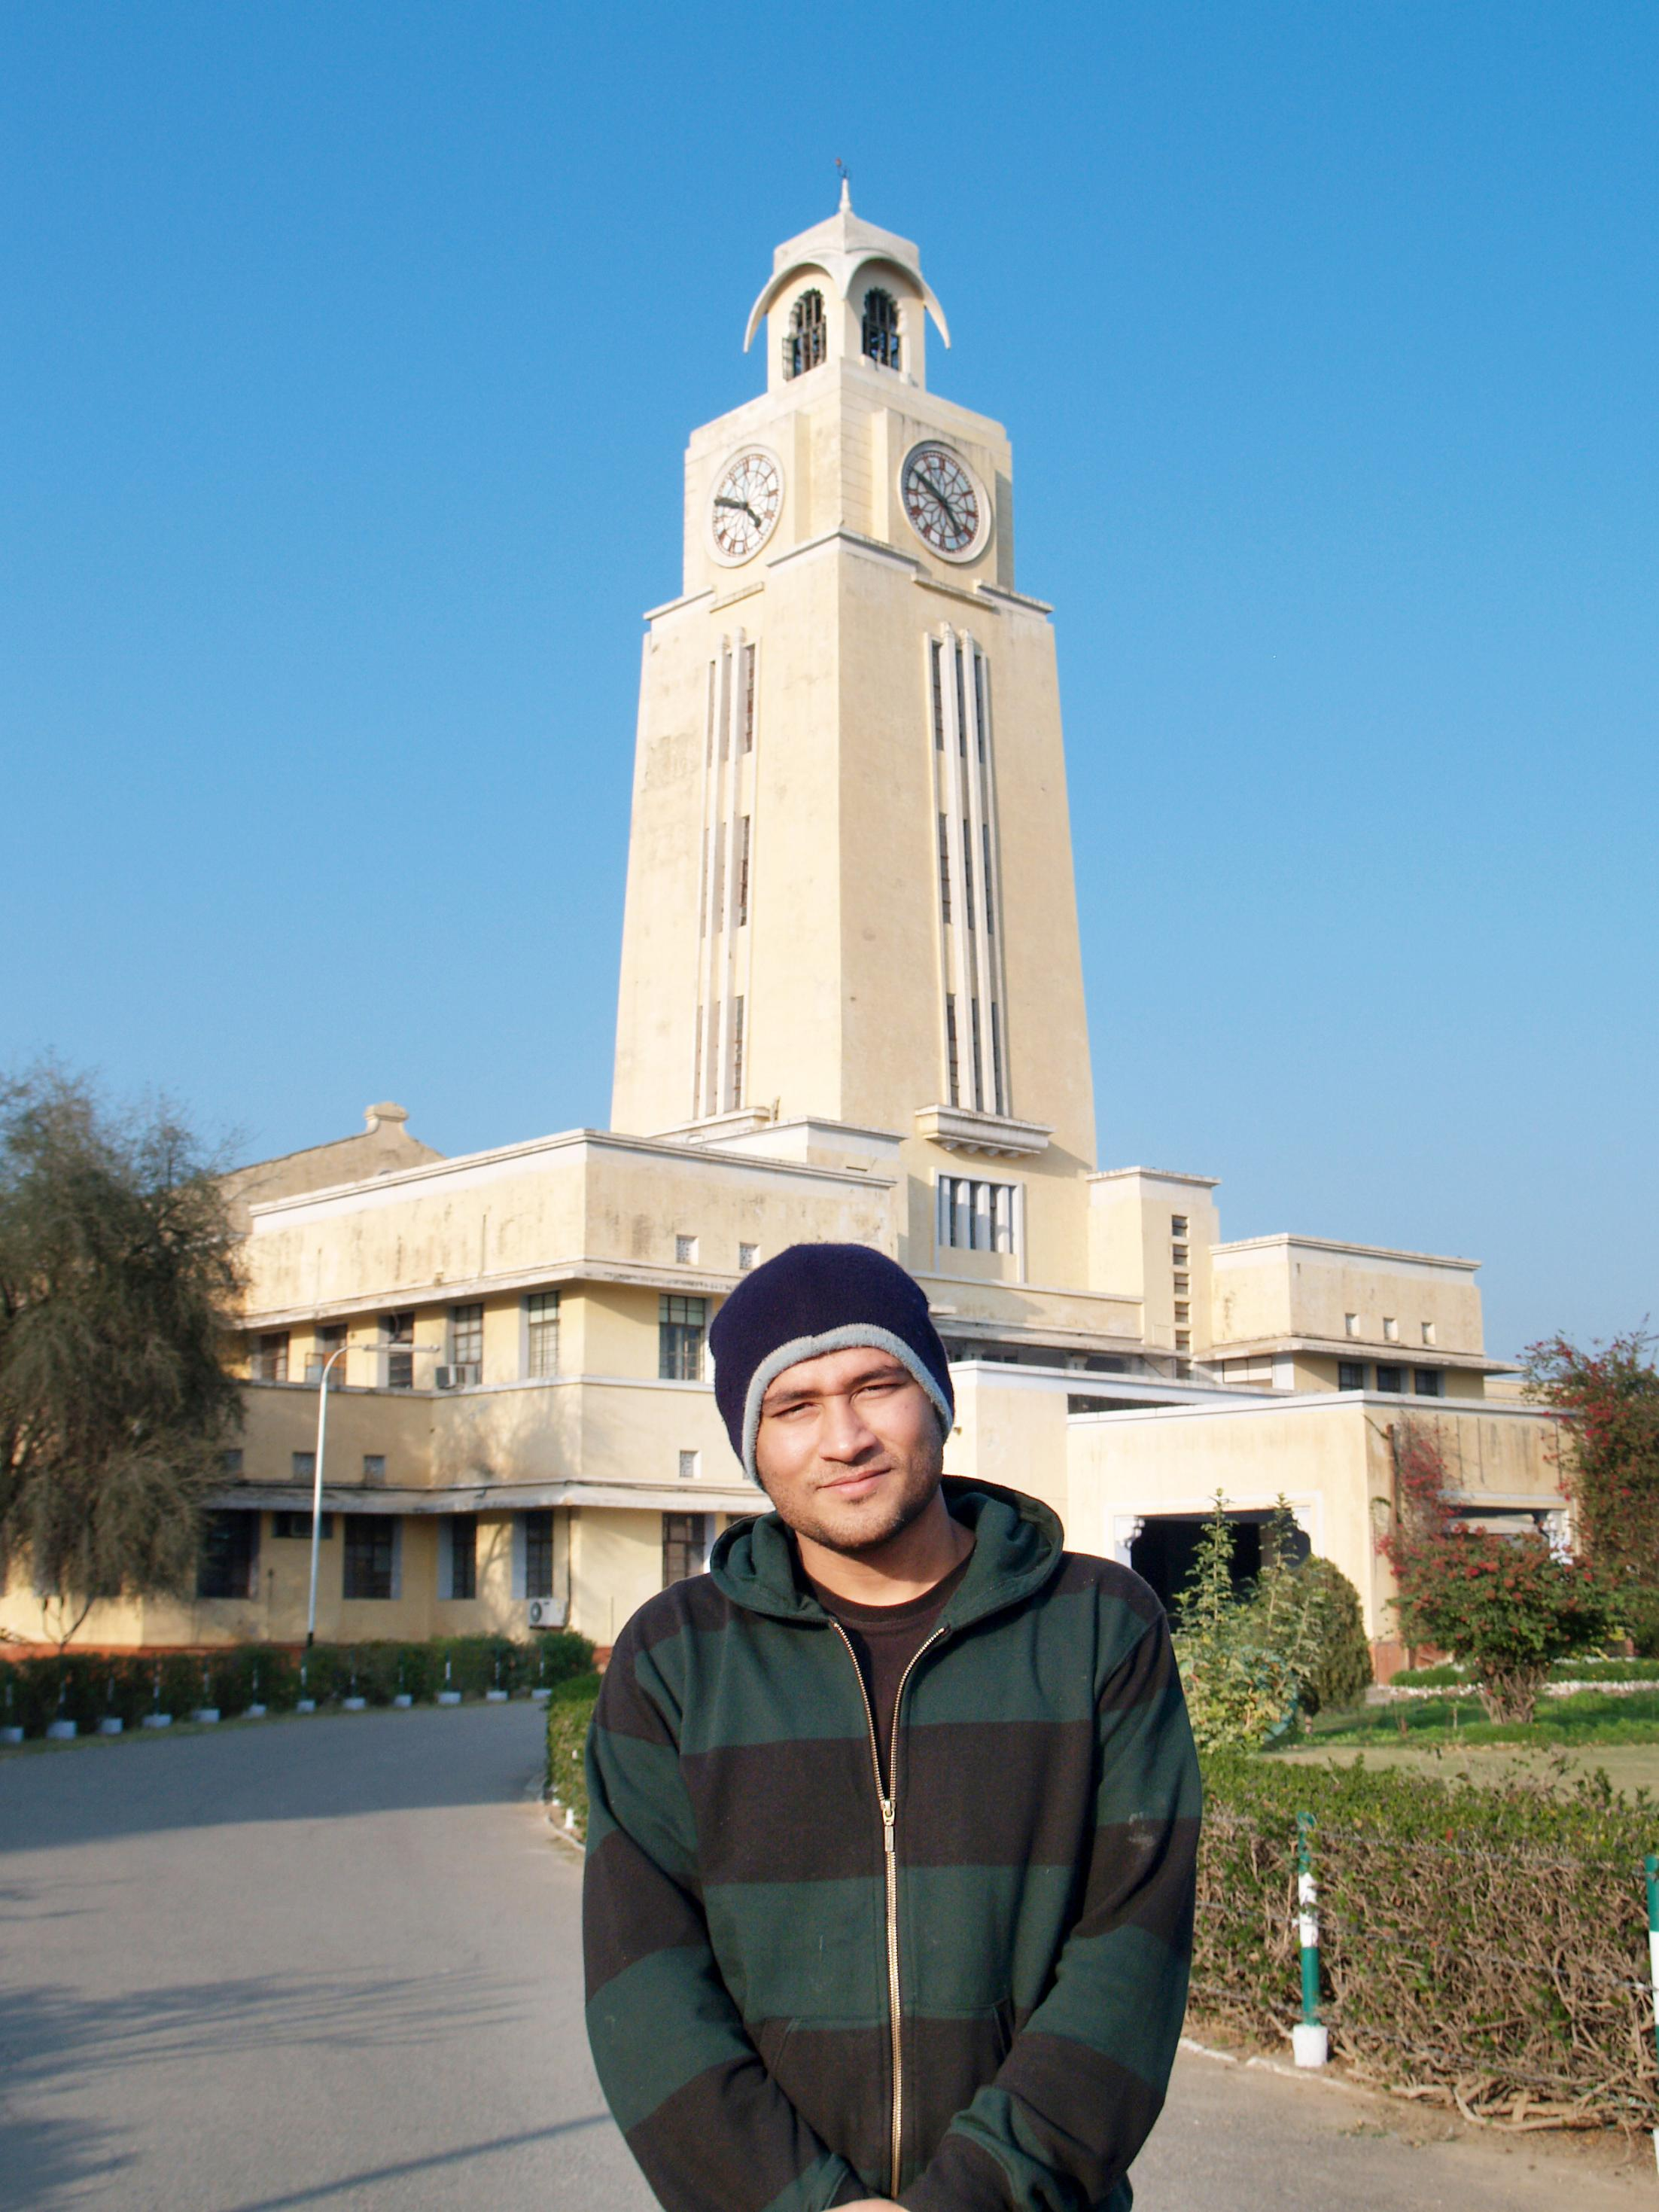

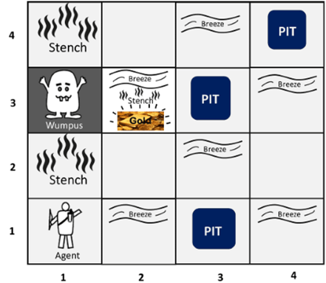

BITS Pilani
Pilani Campus
(some slides adapted from Stuart http://aima.cs.berkeley.edu/)
DSE CL 557 - Artificial and Computational Intelligence
#10. Logical Agent (Cont..)
Sunday, December 6, 2020
Dr. Saikishor Jangiti

Slide 2
Today
Inference rules and theorem proving
Forward chaining
Backward chaining
Resolution
DPLL Algorithm
Agents based on Propositional logic
Overview of FOL semantics and representation
Reference: Chapter 7.5 to 7.7 & 8.1 from AI: A modern approach (Russell, Norvig)

Slide 3
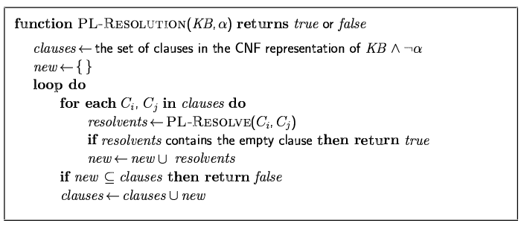
Resolution algorithm
Proof by contradiction, i.e., show KB∧¬α unsatisfiable

Slide 4
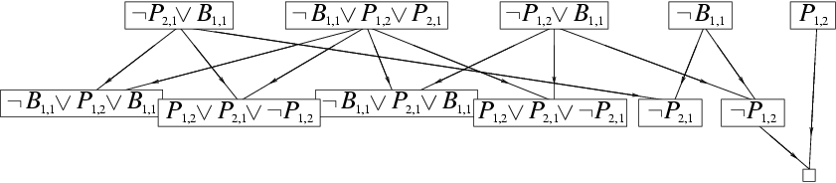
Resolution example
KB = (B_{1,1} ⇔ (P_{1,2}∨ P_{2,1})) ∧¬ B_{1,1} α = ¬P_{1,2}

Slide 5
Forward and backward chaining
Horn Form (restricted)
KB = conjunction of Horn clauses
Horn clause =
proposition symbol; or
(conjunction of symbols) ⇒ symbol
E.g., C ∧ (B ⇒ A) ∧ (C ∧ D ⇒ B)
Modus Ponens (for Horn Form): complete for Horn KBs
α₁, … ,α_{n}, α₁ ∧ … ∧ α_{n} ⇒ β
β
Can be used with forward chaining or backward chaining.
These algorithms are very natural and run in linear time

Slide 6
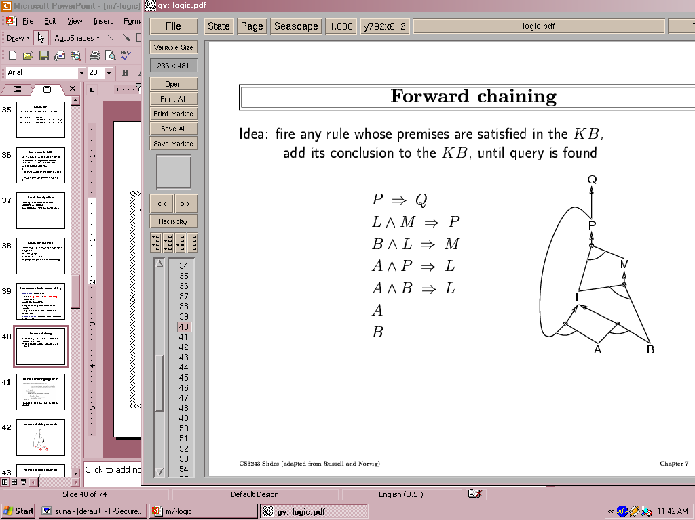
Forward chaining
Idea: fire any rule whose premises are satisfied in the KB,
add its conclusion to the KB, until query is found

Slide 7
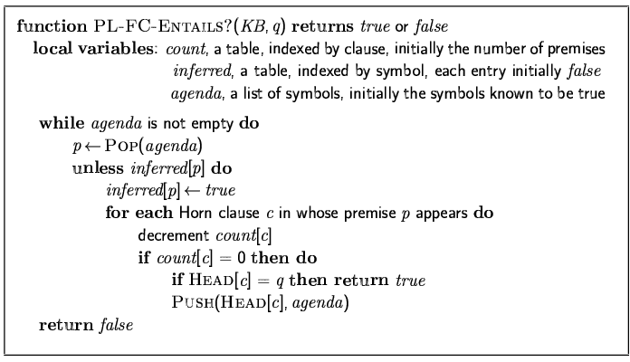
Forward chaining algorithm
Forward chaining is sound and complete for Horn KB

Slide 8
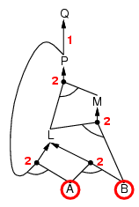
Forward chaining example

Slide 9
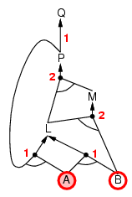
Forward chaining example

Slide 10
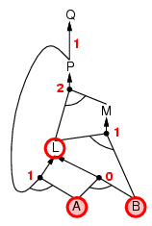
Forward chaining example

Slide 11
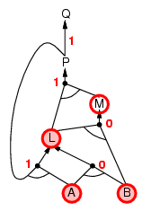
Forward chaining example

Slide 12
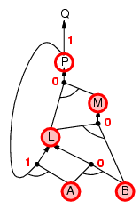
Forward chaining example

Slide 13
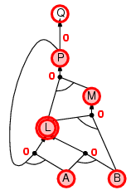
Forward chaining example

Slide 14
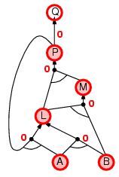
Forward chaining example

Slide 15

Forward chaining example

Slide 16
Proof of completeness
FC derives every atomic sentence that is entailed by KB
FC reaches a fixed point where no new atomic sentences are derived
Consider the final state as a model m, assigning true/false to symbols
Every clause in the original KB is true in m
a₁ ∧ … ∧ a_{k ⇒} b
Hence m is a model of KB
If KB╞ q, q is true in every model of KB, including m

Slide 17
Backward chaining
Idea: work backwards from the query q:
to prove q by BC,
check if q is known already, or
prove by BC all premises of some rule concluding q
Avoid loops: check if new subgoal is already on the goal stack
Avoid repeated work: check if new subgoal
has already been proved true, or
has already failed

Slide 18
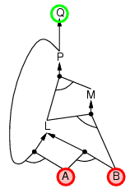
Backward chaining example

Slide 19
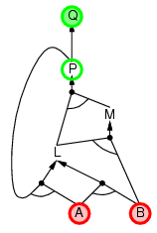
Backward chaining example

Slide 20
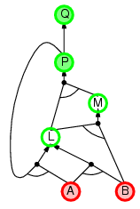
Backward chaining example

Slide 21
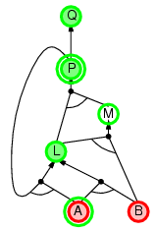
Backward chaining example

Slide 22
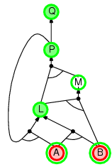
Backward chaining example

Slide 23
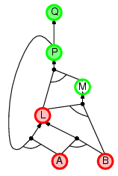
Backward chaining example

Slide 24
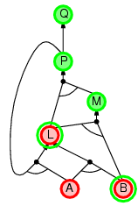
Backward chaining example

Slide 25
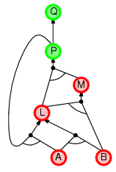
Backward chaining example

Slide 26
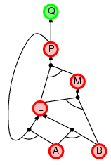
Backward chaining example

Slide 27
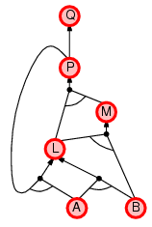
Backward chaining example

Slide 28
Forward vs. backward chaining
FC is data-driven, automatic, unconscious processing,
e.g., object recognition, routine decisions
May do lots of work that is irrelevant to the goal
BC is goal-driven, appropriate for problem-solving,
e.g., Where are my keys? How do I get into a PhD program?
Complexity of BC can be much less than linear in size of KB

Slide 29
Efficient propositional inference
Two families of efficient algorithms for propositional inference:
Complete backtracking search algorithms
DPLL algorithm (Davis, Putnam, Logemann, Loveland)
Incomplete local search algorithms
WalkSAT algorithm

Slide 30
The DPLL algorithm
Determine if an input propositional logic sentence (in CNF) is satisfiable.
Improvements over truth table enumeration:
Early termination
A clause is true if any literal is true.
A sentence is false if any clause is false.
Pure symbol heuristic
Pure symbol: always appears with the same "sign" in all clauses.
e.g., In the three clauses (A ∨ ¬B), (¬B ∨ ¬C), (C ∨ A), A and B are pure, C is impure.
Make a pure symbol literal true.
Unit clause heuristic
Unit clause: only one literal in the clause
The only literal in a unit clause must be true.

Slide 31
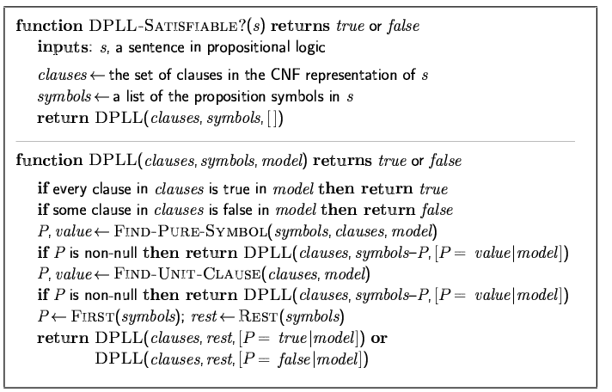
The DPLL algorithm

Slide 32
Inference-based agents in the wumpus world
A wumpus-world agent using propositional logic:
¬P_{1,1}
¬W_{1,1}
B_{x,y} ⇔ (P_{x,y+1} ∨ P_{x,y-1} ∨ P_{x+1,y} ∨ P_{x-1,y})
S_{x,y} ⇔ (W_{x,y+1} ∨ W_{x,y-1} ∨ W_{x+1,y} ∨ W_{x-1,y})
W_{1,1} ∨ W_{1,2} ∨ … ∨ W_{4,4}
¬W_{1,1} ∨ ¬W_{1,2}
¬W_{1,1} ∨ ¬W_{1,3}
…
⇒ 64 distinct proposition symbols, 155 sentences

Slide 33
Expressiveness limitation of propositional logic
KB contains "physics" sentences for every single square
For every time t and every location [x,y],
L_{x,y} ∧ FacingRight^{t} ∧ Forward^{t} ⇒ L_{x+1,y}
Rapid proliferation of clauses
t
t

Slide 34
Pros and cons of propositional logic
☺ Propositional logic is declarative
☺ Propositional logic allows partial/disjunctive/negated information
(unlike most data structures and databases)
Propositional logic is compositional:
meaning of B_{1,1} ∧ P_{1,2} is derived from meaning of B_{1,1} and of P_{1,2}
☺ Meaning in propositional logic is context-independent
(unlike natural language, where meaning depends on context)
☹ Propositional logic has very limited expressive power
(unlike natural language)
E.g., cannot say "pits cause breezes in adjacent squares“
except by writing one sentence for each square

Slide 35
First-order logic
Whereas propositional logic assumes the world contains facts,
first-order logic (like natural language) assumes the world contains
Objects: people, houses, numbers, colors, baseball games, wars, …
Relations: red, round, prime, brother of, bigger than, part of, comes between, …
Functions: father of, best friend, one more than, plus, …

Slide 36
Syntax of FOL: Basic elements
Constants KingJohn, 2, NUS,...
Predicates Brother, >,...
Functions Sqrt, LeftLegOf,...
Variables x, y, a, b,...
Connectives ¬, ⇒, ∧, ∨, ⇔
Equality =
Quantifiers ∀, ∃

Slide 37
Atomic sentences
Atomic sentence = predicate (term₁,...,term_{n}) or term₁ = term₂
Term = function (term₁,...,term_{n}) or constant or variable
E.g., Brother(KingJohn,RichardTheLionheart) > (Length(LeftLegOf(Richard)), Length(LeftLegOf(KingJohn)))

Slide 38
Complex sentences
Complex sentences are made from atomic sentences using connectives
¬S, S₁ ∧ S₂, S₁ ∨ S₂, S₁ ⇒ S₂, S₁ ⇔ S₂,
E.g. Sibling(KingJohn,Richard) ⇒ Sibling(Richard,KingJohn)
>(1,2) ∨ ≤ (1,2)
>(1,2) ∧ ¬ >(1,2)

Slide 39
Truth in first-order logic
Sentences are true with respect to a model and an interpretation
Model contains objects (domain elements) and relations among them
Interpretation specifies referents for
constant symbols → objects
predicate symbols → relations
function symbols → functional relations
An atomic sentence predicate(term₁,...,term_{n}) is true
iff the objects referred to by term₁,...,term_{n}
are in the relation referred to by predicate

Slide 40
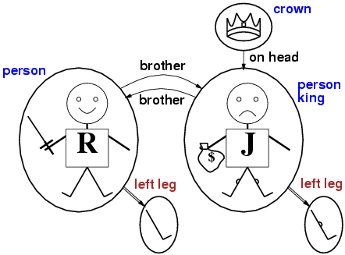
Models for FOL: Example

Slide 41
Universal quantification
∀<variables> <sentence>
Everyone at NUS is smart:
∀x At(x,NUS) ⇒ Smart(x)
∀x P is true in a model m iff P is true with x being each possible object in the model
Roughly speaking, equivalent to the conjunction of instantiations of P
At(KingJohn,NUS) ⇒ Smart(KingJohn)
∧ At(Richard,NUS) ⇒ Smart(Richard)
∧ At(NUS,NUS) ⇒ Smart(NUS)
∧ ...

Slide 42
A common mistake to avoid
Typically, ⇒ is the main connective with ∀
Common mistake: using ∧ as the main connective with ∀:
∀x At(x,NUS) ∧ Smart(x)
means “Everyone is at NUS and everyone is smart”

Slide 43
Existential quantification
∃<variables> <sentence>
Someone at NUS is smart:
∃x At(x,NUS) ∧ Smart(x)$
∃x P is true in a model m iff P is true with x being some possible object in the model
Roughly speaking, equivalent to the disjunction of instantiations of P
At(KingJohn,NUS) ∧ Smart(KingJohn)
∨ At(Richard,NUS) ∧ Smart(Richard)
∨ At(NUS,NUS) ∧ Smart(NUS)
∨ ...

Slide 44
Another common mistake to avoid
Typically, ∧ is the main connective with ∃
Common mistake: using ⇒ as the main connective with ∃:
∃x At(x,NUS) ⇒ Smart(x)
is true if there is anyone who is not at NUS!

Slide 45
Properties of quantifiers
∀x ∀y is the same as ∀y ∀x
∃x ∃y is the same as ∃y ∃x
∃x ∀y is not the same as ∀y ∃x
∃x ∀y Loves(x,y)
“There is a person who loves everyone in the world”
∀y ∃x Loves(x,y)
“Everyone in the world is loved by at least one person”
Quantifier duality: each can be expressed using the other
∀x Likes(x,IceCream) ¬∃x ¬Likes(x,IceCream)
∃x Likes(x,Broccoli) ¬∀x ¬Likes(x,Broccoli)

Slide 46
Equality
term₁ = term₂ is true under a given interpretation if and only if term₁ and term₂ refer to the same object
E.g., definition of Sibling in terms of Parent:
∀x,y Sibling(x,y) ⇔ [¬(x = y) ∧ ∃m,f ¬ (m = f) ∧ Parent(m,x) ∧ Parent(f,x) ∧ Parent(m,y) ∧ Parent(f,y)]

Slide 47
Using FOL
The kinship domain:
Brothers are siblings
∀x,y Brother(x,y) ⇔ Sibling(x,y)
One's mother is one's female parent
∀m,c Mother(c) = m ⇔ (Female(m) ∧ Parent(m,c))
“Sibling” is symmetric
∀x,y Sibling(x,y) ⇔ Sibling(y,x)

Slide 48
Using FOL
The set domain:
∀s Set(s) ⇔ (s = {} ) ∨ (∃x,s₂ Set(s₂) ∧ s = {x|s₂})
¬∃x,s {x|s} = {}
∀x,s x ∈ s ⇔ s = {x|s}
∀x,s x ∈ s ⇔ [ ∃y,s₂} (s = {y|s₂} ∧ (x = y ∨ x ∈ s₂))]
∀s₁,s₂ s₁ ⊆ s₂ ⇔ (∀x x ∈ s₁ ⇒ x ∈ s₂)
∀s₁,s₂ (s₁ = s₂) ⇔ (s₁ ⊆ s₂ ∧ s₂ ⊆ s₁)
∀x,s₁,s₂ x ∈ (s₁ ∩ s₂) ⇔ (x ∈ s₁ ∧ x ∈ s₂)
∀x,s₁,s₂ x ∈ (s₁ ∪ s₂) ⇔ (x ∈ s₁ ∨ x ∈ s₂)

Slide 49
Interacting with FOL KBs
Suppose a wumpus-world agent is using an FOL KB and perceives a smell and a breeze (but no glitter) at t=5:
Tell(KB,Percept([Smell,Breeze,None],5))
Ask(KB,∃a BestAction(a,5))
I.e., does the KB entail some best action at t=5?
Answer: Yes, {a/Shoot} ← substitution (binding list)
Given a sentence S and a substitution σ,
Sσ denotes the result of plugging σ into S; e.g.,
S = Smarter(x,y)
σ = {x/Hillary,y/Bill}
Sσ = Smarter(Hillary,Bill)
Ask(KB,S) returns some/all σ such that KB╞ σ

Slide 50
Knowledge base for the wumpus world
Perception
∀t,s,b Percept([s,b,Glitter],t) ⇒ Glitter(t)
Reflex
∀t Glitter(t) ⇒ BestAction(Grab,t)

Slide 51
Deducing hidden properties
∀x,y,a,b Adjacent([x,y],[a,b]) ⇔
[a,b] ∈ {[x+1,y], [x-1,y],[x,y+1],[x,y-1]}
Properties of squares:
∀s,t At(Agent,s,t) ∧ Breeze(t) ⇒ Breezy(s)
Squares are breezy near a pit:
Diagnostic rule---infer cause from effect
∀s Breezy(s) ⇒ \Exi{r} Adjacent(r,s) ∧ Pit(r)$
Causal rule---infer effect from cause
∀r Pit(r) ⇒ [∀s Adjacent(r,s) ⇒ Breezy(s)$ ]

Slide 52
Summary
First-order logic:
objects and relations are semantic primitives
syntax: constants, functions, predicates, equality, quantifiers
Increased expressive power: sufficient to define wumpus world

Slide 53
Thank you for your Attention
Any more queries

